Slide 1
Project MLOps
Mathias Goris & Arthur Hofman

Slide 2
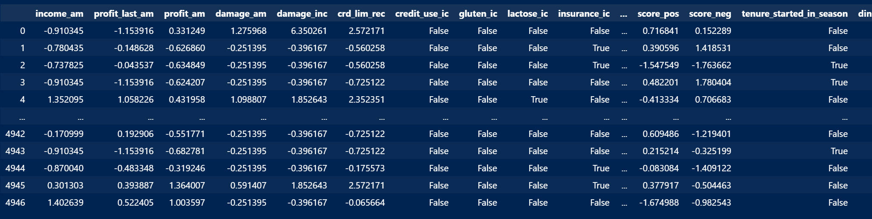
Project Context
Smurf Guest Profit Predictor
training set = behavior of 5000 Smurf hotel guests

Slide 3
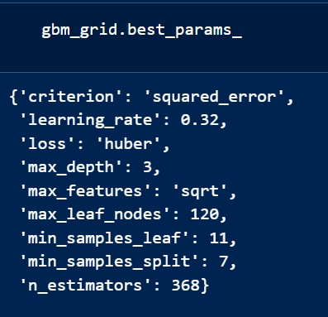
Machine learning model
GradientBoostingRegressor
Beste performance in vorig project
Gebruikt clean dataset

Slide 4
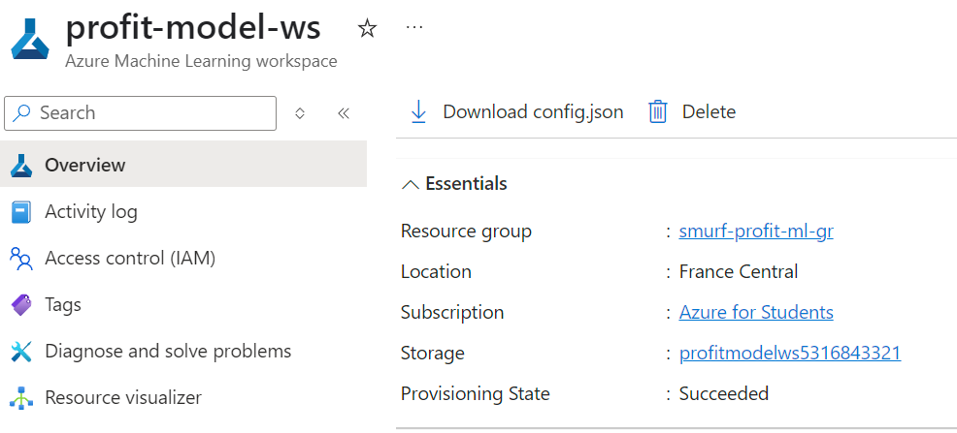
Azure ML Setup (Task 1)
Resource group: smurf-profit-ml-gr
Workspace: profit-model-ws
Computes: cc-profit-train, ci-profit-dev
Registered cleaned dataset
App Registration voor GitHub: github-ml-pipeline

Slide 5
FastAPI & Kubernetes (Task 2)

Slide 6
Automation & DevOps (Task 3)

Slide 7
Challenges & Learnings

Slide 8
Demo & Result

Slide 9
Einde
Zijn er nog vragen?

